Slide 1
Intro to MIPS
Dr. John Abraham
Professor UTRGV

Slide 2
Motivation
We are in Chapter 8 now. We will be skipping Chapters 9, 10 and 11. You learned these in other courses.
Chapter 9 deals with number systems, Binary, Octal, hexadecimal and decimal.
Chapter 10 deals with Computer Math, signed and unsigned integers, and floating point.
Chapter 11 deals with digital logic, Boolean, combinational circuits, adders, and flip-flops.
We are going to discuss Pipelining in Chapter 13.
It is important you will be ready for that chapter. Thus we will start with MIPS. There will be some lab assignments on this topic.

Slide 3
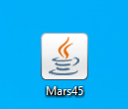
Download MARS
Make sure you have JAVA installed.
Please go to http://courses.missouristate.edu/kenvollmar/mars/
After download I moved it to desktop and ran directly from there. Looks something like this:
Next slide shows how it runs.

Slide 4
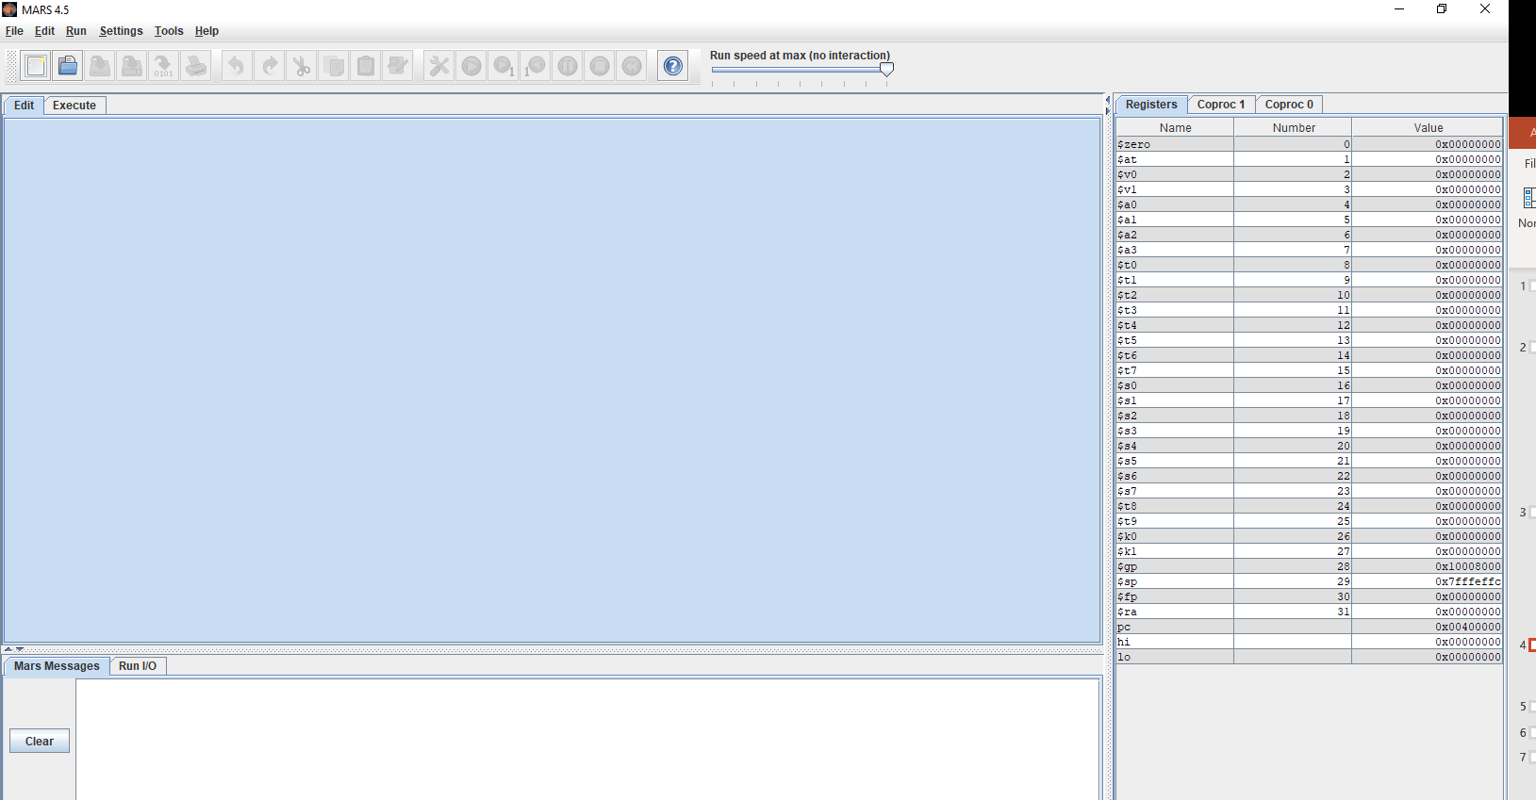
This is how MARS looks like

Slide 5
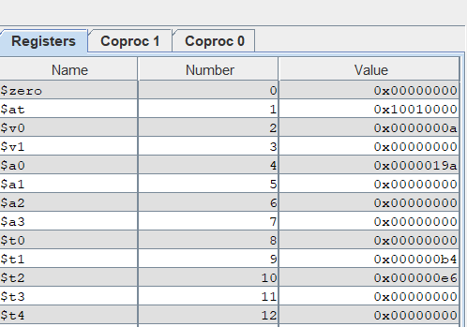
Registers – showing only few
There are 32 integer and 32 floating point registers. MIPS ONLY USES REGISTERS. VARIABLES WILL HAVE TO BE BROUGHT INTO REGISTERS FIRST. Feel free to use $t1 … temporary registers. See next slide to learn more about integer registers.

Slide 6
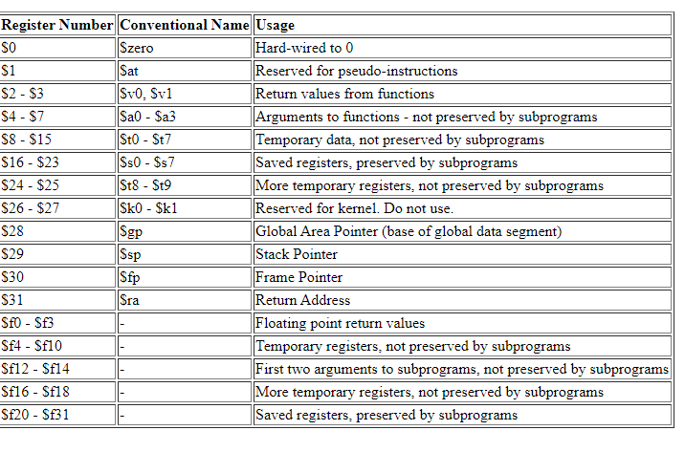
Registers explained

Slide 7
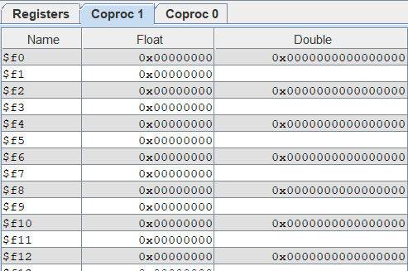
Floating point registers

Slide 8
MIPS program
You should start by creating a new program from dropdown menu “File”
Two parts
Data
Txt
If you recall we have been writing assembly for C=A+B; we will do the same as your first MIPS MARS program.

Slide 9
Useful Information about MIPS
Comment #
Assembler directive .data, .asciiz, .global
Operation mnemonic add, addi, lw, bne
Register name $10, $t2
Address label (decl) hello:, length:, loop:
Address label (use) hello, length, loop
Integer constant 16, -8, 0xA4
String constant "Hello, world!\n"
Character constant ’H’, ’?’, ’\n’

Slide 10
.Data section
Contains all variables and values you want to provide to the program.
You also need to provide data types
For example
.asciiz “\nThis program adds two numbers\n”
firstNum: .word 594
secondNum: .word 816
oneChar: .byte “y”
Pi: .float 3.14

Slide 11
Hello world program
# Description: A simple hello world program!
.data # add this stuff to the data segment
hello: .asciiz "Hello, world!" # load the hello string into data memory
.text # now we’re in the text segment
li $v0, 4 # set up print string syscall
la $a0, hello # argument to print string
syscall # tell the OS to do the syscall
li $v0, 10 # set up exit syscall
syscall # tell the OS to do the syscall

Slide 12
Some explanation
li $v0, 4 -- load immediate 4 into $v0
Look at the help I gave along with the assignment, which shows $v0 values and what they mean. For example, if it is a 1 it expects to print an integer in $a0 (argument register 0). In our hello world example, we are placing a value of 4 in $v0 and the string in $a0
Syscall – asking operating system to perform the above code.

Slide 13
Service | Code in $v0 | Arguments | Result
print integer | 1 | $a0 = integer to print
print float | 2 | $f12 = float to print
print double | 3 | $f12 = double to print
print string | 4 | $a0 = address of null-terminated string to print
read integer | 5 |  | $v0 contains integer read
read float | 6 |  | $f0 contains float read
read double | 7 |  | $f0 contains double read

Slide 14
2 ways to get a number in the register
# first way to put in RAM
.data
aNum: .word 300
.text
lw $t1, aNum # and then bring to register
li $v0, 1
addi $a0,$zero, 100 #second way to use addi
add $a0, $a0, $t1
syscall
400

